Slide 1



Government & Entrepreneurship
Fall 2018 STS2850
Prof. Jim Cheng
10/22/2018
Class 15
Updated version

Slide 2

Before we start Govt K….
What is your process for buying something?
What have you bought recently? Costly/cheap?
At what point do you have to consult another person for approval, budget, tech advice, etc?
What is more important? Features, price, a combination of both, or something else?
What is the purchasing process in a company?
How does that differ with how Government buys products and services?

Slide 3
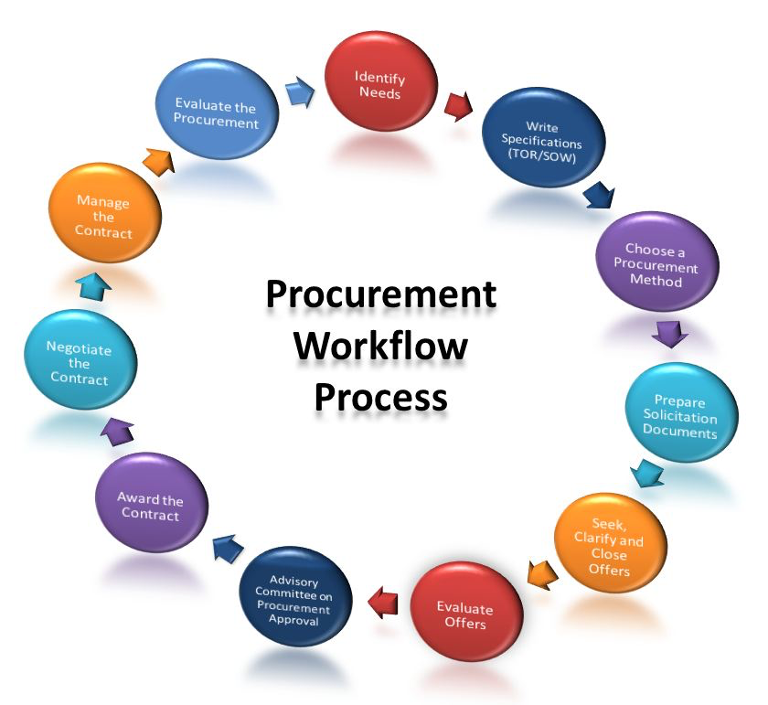
Companies and governments do something like this, when they procure things….

Slide 4
Typical Procurement Process
Identify a need
Create a solicitation (RFP/RFQ/Purchase order)
Advertise for offers
Evaluate offers/Negotiate with finalists
Award the contract
Manage the contract

Slide 5
The US Government Market
The proposed US budget for 2015 is $3.9 Trillion, up from $3.7 Trillion in 2014
The Defense budget is over $600 Billion and the Civilian agencies’ budget is over $540 Billion; the balance is entitlements and interest
Of these amounts, over $1 Trillion is spent on contracts and grants (the addressable market)
In particular, the Federal IT budget exceeds $80 Billion; slightly skewed to the Civilian side
This is an enormous market! A $100 Million company has a .1% market share.
Credit: Dr. Ed Bersoff

Slide 6
Government Contracting
The Gov’t procurement process is designed to ensure fair and transparent competition for awarding contracts; plus it is meant to ensure that a consistent, standard product or service is procured, to meet the government’s needs.
Many large companies use similar processes…But...
The Government is held to a higher standard! Why?
Government spends YOUR taxpayer money.
Misuse of taxpayer money is a crime
Cannot show favoritism to a particular vendor
Poorly procured mission critical items could result in poor service, financial loss, injury or death.
Must make decisions which are answerable to the citizenry.
Agency managers and leaders
Government may also use policies to effect social policy (Small Business set asides).

Slide 7
Government Contracting
Govt Contracting has many additional rules and regulations*
The Government effects social policy through contracting:
Hiring and wage guidelines, beyond “Minimum Wage”.
Drug-free workplace and others personnel policies…
Special advantages given to Minorities, Women, SDVOB’s and small business.
Special rules apply to Government Contractors… because they get paid with taxpayer money.
Ethics – including TINA- Truth in Negotiation Act – Contractors must beware…
The Government may terminate a contract for its “convenience”
But the Govt must compensate the contractor for costs incurred.
Govt Contracting may include a security clearance or other security requirement.
Plus additional data and physical security requirements.
The Govt has special rights to perform audits and reviews of contractors.
Government accounting is one of the reasons why many firms refuse to do business with govt
*This is just a brief summary of some of the additional rules and regs, there are many, many more

Slide 8
Getting Started
Government Contracting is regulated by the Federal Acquisition Regulations (FAR/DFAR) in the US Code.
Government contractors, subcontractors and their employees are subject to the FAR in most instances.
Type of company – products or services
What do you sell?
Type of offering – IT, analysis, or engineering
The US Govt buys everything through the procurement process. A lot of it is low-margin commodity products. But technical products/services offer the vendor higher margin opportunity.
Target market – defense, intelligence, civilian
All 15 Major executive agencies and independent agencies…
Some operate outside of FAR, like the FAA.
Credit: Dr. Ed Bersoff

Slide 9
Who are the key Gov’t players?
Contracting Office (Procurement office)
Purchasing authority – A Contracting Officer is the only person authorized to commit the government (Other than agency head).
Small and Disadvantaged Business Utilization Specialist
SADBU offices or OSDBU – every Contracting office has a specialist assigned to assist small business
Technical Buyer/COTR* (Requirements office)
They have the “Need” and provide the “Technical Specifications” (which are part of the RFP (Request for Proposals or “Tender”).
Source Selection Board* (Review team)
They make the recommendation based on RFP responses.
Contracting office may use recommendation for award.
*As an engineer, you may be asked to serve as/on one of these
** Note: terminology may differ from agency to agency

Slide 10
Government Set-Asides
Procurement preferences – 23% of all Government contracts are reserved for Small Business. (this is a good example of a Govt Social Policy lever).
The Gov’t is required to “Set-aside” or reserve 23% of all contracts for Small Business.
Of the 23%, SDVOB (3%), minority owned(5%), woman owned(5%), HUBZone(3%)
“Small Business” as defined by North American Industry Classification System Codes (NAICS)... Which defines a “Size Standard” for the universe of recognized industries.
All purchases under $150,000 are reserved exclusively for small businesses. Procurements over $150K may be set-aside under the “rule of two”.
ALL purchases/procurements over $25,000 are advertised on FBO (Fed Biz Opps). Small business set-asides are easily searchable.
Also, the HubZone and SBA 8(a) programs allow for “single source” awards to qualified contractors… no Bidding/Competition needed for a contract award.
Large contractors are required to target percentages for Small Business Sub-Contractors… Which is sometimes hard to enforce.

Slide 11
Key Govt Contracting Concepts
Type of Solicitation
RFP- Request for Proposals
RFQ- Request for Quotes
RFI - Request for Information (Looking for sources)
BPA- Blanket Purchase Agreement
Type of Contract
FFP – Firm Fixed Price (High risk for Govt)
Flat fee for the project
T&M – Time and Materials (Medium risk)
“Fixed price labor hour”, plus materials reimbursement
CPFF/CPAF- Cost Plus Fixed Fee (or Award Fee)
All allowed costs are recoverable - Low risk (in the eyes of the Government)
Certain “Commercial Off the Shelf” (COTS) items may be purchased through a pre-awarded/negotiated contract, called GSA Schedules.
Government places ceiling (up to 15%) on “fee” or profit for certain types of contracts.

Slide 12
Typical Procurement Process
Identify a need
Tech + Contracting Office
Create a solicitation (RFP/RFQ, etc)
Advertise for offers
Evaluate offers/Negotiate with finalists
Tech assists evaluation and negotiation
Award the contract
Manage the contract
Tech assists in management and administration

Slide 13
Government Contracting (other)
Govt has other programs to assist small business-
SBIR/STTR- Small Business Innovation Research & Small Business Tech Transfer programs. Encourages small business R&D… available in three phases.
Phase I - up to $150K (usually a study).
Phase II – up to $1M (usually a protoype or small production run).
Phase III – For Commercialization… no direct R&D funding, but encourages US Govt agencies to purchase
Each Agency has its own program and advertises its needs… contractors are encouraged to contact the agency points of contact (unlike normal govt contracting).
Non-dilutive (it’s a grant), contractor keeps intellectual property

Slide 14
Differences Between Govt and Commercial Contracts
Government contracting
Commercial Contracting
Federal Acquisitions Regulations (FAR/DFAR).
Govt will have non-negotiable terms (workplace laws, audit rights, etc…).
Govt may unilaterally modify or cancel contract or cancel at any time (with compensation to contractor).
Govt may limit profits and set strict payment rules.
Govt enforces social and other goals “for the best interests of the Government”. Ie… Set-asides.
Uniform Commercial Code (UCC), and state laws.
Generally both parties may mutually change terms via contract.

Slide 15
Other thoughts on Commercial vs Govt Market
Because the US Gov’t Market size is dependent on the National Budget, the total market size is predictable and limited.
Vs. the commercial/consumer market – which is regarded as unlimited.
However, other allied and friendly countries may need same product.
Per the above – it may be difficult to penetrate the Govt Market because each Govt agency and dept will have a set budget, which is transparent and public… in a shrinking or a stagnant budget (think CRA or sequestration), the primary way to “break into” a new client department is to take work from an “incumbent”. The incumbent competes via a procurement process that is difficult (for a newcomer) to change.
Compare to commercial/consumer market – new disruptive products may be able “sneak” into a market, reach a tipping point, and expand market share greatly… through word of mouth and “viral marketing”.

Slide 16
Other thoughts on Commercial vs Govt Market
The Govt procurement process is bureaucratic and stilted, and there seems to be a set “business model” in which govt contractors operate… and VP/CS seems diminished.
But, “people still buy from people”, experienced Govt Contractors use small business programs and upfront marketing introduce innovative products to Govt buyers.
For example, early in the North Face case, they directly worked with the Govt in designing new products. But lost the access as they grew bigger…
How could they get that access back?
Is CS, VP and the Business Model Canvas still relevant?

Slide 17
Other thoughts on Commercial vs Govt Market
Because of the massive size of the Govt Market, sometimes the Govt is slow to use new technology.
But the Govt (usually Govt Labs and research organizations) is often on the forefront of developing and funding new products.
As such, the Govt is involved is setting industry standards in new industries (usually with industry input).
And once the technology is mainstream, the Government is often a large purchaser and supporter of the tech.
In this respect, the Govt is also (often) a leading agent of innovation.

Slide 18
Fed Biz Opps
Fed Biz Opps or FBO.gov – is the online version of paper “CBD”
Before, the Commerce Business Daily (CBD) was delivered by mail every day.
All Federal Opportunities, awards, etc… over $25K are advertised on the FBO.
So everyone knows about FBO opportunities as they are published.
So smart contractors try to influence these opportunities before they show up on the FBO.

Slide 19
FBO Searches
Search using Industry NAICS codes
Ie… 22114 – Solar Energy
Search Classifications codes
10-99 for things (70- IT equip, 65- Med supplies)
A-Z for Services (A- R&D, Q-Medical, etc)
Or search keywords
Try “sustainable”, “arctic” or “Prison”
Then refine the search (too many results), and pick one!

Slide 20
FBO Searches
Read guidance in resources for FBO pitch paper
Watch the pitch videos
Watch the TED Talk on body language
Do your search
Use your imagination
Don’t obsess, there is no right answer… this is pass/fail…
Practice makes perfect

